Slide 1
Bismillahir Rahmanir Rahim
Design and Implementation of an IoT Based Indoor Air Quality Monitoring System
Submitted by:
Md.Didarul Alam Toshif
Metric ID : T-163023
Mahmudul Hasan
Metric ID : T-163009
Supervised by:
Engr. Abdul Gafur
Associate Professor
Dept. of ETE, IIUC
Department of Electronic and Telecommunications Engineering
International Islamic University Chittagong

Slide 2

Supervisor Permission Proof

Slide 3
Contents
Introduction
Motivation
Literature Review
Objective
Methodology
Required Components
Flow Chart
Circuit Diagram
Hardware Implementation
Result
Future Work
Gantt Chart
Reference

Slide 4
Abstract
Abstract: Observing of air quality is turning out to be more furthermore, more significant step by step due to huge effects of air contamination on general wellbeing, worldwide environment, and overall economy. With the ceaseless advancement of the Internet of Things (IoT) is turning out to be logically more significant for air observing, traffic checking, shrewd home control, keen stopping the board and other modern and home applications. In this paper, we propose a keen continuous Air Monitoring System with crisis alert dependent on Web of Things (IoT), which permits clients to follow the encompassing air nature of their home or office or enterprises from anyplace. An alert goes to client of the framework if there should arise an occurrence of any crisis perilous circumstance.

Slide 5
INTRODUCTION
The Internet of things (IoT) is the network of physical devices embedded with electronics, software, sensors, actuators, and network connectivity.
IoT enables these objects to collect and exchange data by themselves.
INTERNET works as the heart of the system.

Slide 6

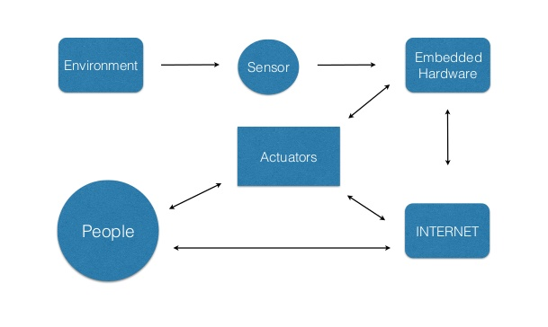

INTRODUCTION
Fig. 1. Working principle of Internet of Things (IoT)

Slide 7
MOTIVATION
For health protection, the public needs timely information about air quality and other factors (e.g., weather conditions) that affect it. ... The main goal of this project is to monitor the air pollution, hazardous gases and increase awareness about pollution by using air pollution monitoring system.

Slide 8
LITERATURE REVIEW
Factors | Ref. No [1] | Ref. No [2] | Ref. No [3] | Ref. No [4]
Year | 2019 (ICAEE) Bangladesh | 2019 (IJACSA) | 2019 (IEEE) | 2018 (IJRTE)
Title | Design & Implementation of an IoT based air pollution detection & monitoring system | Evaluation of LoRa Based air pollution monitoring system | IoT based Indoor air Quality Monitoring System | IoT Enabled Air Pollution Monitoring & Awareness Creation System
Arthos | MD. Shahedul Islam & Md. Kaiser Raihan | Neal Abd Alfatah Husein & Abdul Hadi Abd Rahman | Ravi Kishore Kodali | K . Pritheka & P . Varuna
GSM | 1
MQ-04 | 1
MQ-135 | 2 | 3 | 1 | 1
MQ-07 | 1 | 3 | 1 | 1
Dust | 1 |  | 1 | 1
LM-35 | 1 |  |  | 1
MQ-02 |  | 3 |  | 1
Lora RFM Shleid |  | 4
ESP8266 |  |  | 1 | 1
Summary | The pollution level can be monitored any where using computer or mobile | Based on the practical experiments in the indoor outdoor environment, the system has proven its ability to detect pollution and classify its pollution level | Urban IoTs, in fact, are designed to support the Smart City vision, which aims at exploiting the most advanced communication technologies to support added-value services for the administration of the city and for the citizens. | Used Arduino devices to gather and share the information with each other and also store the information. The system supports the real-time data gathering,

Slide 9
Factors | Ref. No [5] | Ref. No [6] | Ref. No [7] | Ref. No [8]
Year | 2018 (JNCET) | 2018 (ICIRCA) | 2018 (ICICCS) | 2018 (IJSER)
Title | IoT based Air Pollution Monitoring System | IoT based air pollution monitoring and control system | Design & Development of Air Pollution Monitoring System for smart cities | IoT Based Air Pollution Monitoring System
Arthos | Devahema & Abhinav Anand | S. Muthukumar & W. Sherine Mary | G Spandana | Harsh N. Shah & Zishan Khan
GSM |  |  |  | 1
MQ-04 |  | 1
MQ-135 | 1 | 1 | 1 | 1
MQ-06 |  |  |  | 1
MQ-07 |  | 1
Dust |  |  | 1
LM-35 |  |  |  | 1
Humidity |  |  |  | 1
MQ-02 |  |  | 1
Lora RFM Shleid
ESP8266 | 1 | 1 | 1
Summary | Author proposed a system that uses microcontroller for sensing the data and ESP8266 Wi-Fi module to transmit data over internet. | This system is a low cost and provides good results in controlling the air pollution especially in the urban areas. | Data sent to web server via Wi-Fi and those data were displayed using a web page. | Author compared between different existing system used for IoT and choose GSM system for transmision of data.
9

Slide 10
Factors | Ref. No [9] | Ref. No [10]
Year | 2018 (ICEICT) | 2017 (ICAS)
Title | Real time Air Quality Monitoring System for Bangladesh’s perspective based on Internet of things | Implementation of IoT based Indoor air Quality monitoring system
Arthos | Md. Mohiuddin Ahmed, Suraiya Banu & Bijan Paul | Sagar M. Godase, Rahul C. Padalkar
GSM
MQ-03 | 1
MQ-135 |  | 1
MQ-06
MQ-07 | 1 | 1
Dust
LM-35
Humidity
DHT-11 |  | 1
MQ-02 | 1 | 1
Lora RFM Shleid
ESP8266 |  | 1
Summary | The proper implementation of this proposed system can be reduce dangerous acceident that occurs throughout the country. | This system send the pollutant level data the server for furture analysis.

Slide 11
Objective
There are few objectives that need to be achieved at the end of this project. The objectives of this project are:
To design a low cost and portable air quality monitoring system using different types of gas sensors.
To integrate the sensor, Arduino microcontroller and GSM module to form a complete monitoring system.
To transmit and receive data via short message service (SMS) using GSM.

Slide 12
Methodology of the Project
Data collected from Sensors, calculated and transferred to Web server by Arduino.
Calculated output has been transferred to internet using GSM module.
Alert sms at critical condition of the air quality and also displays it at the webpage.
A database has been created to archive air quality history.

Slide 13
Methodology of the Project
BUZZER
Sensor Data
Arduino
GSM
Message
Display
Website
Internet
Fig. 2. Block diagram of of IoT Based indoor air quality Monitoring System

Slide 14
Required Components
Hardware
Microcontroller (Arduino)
GSM Module
DHT-11 Temperature,Humidity
Smoke Sensor (MQ06) LPG
Gas Sensor (MQ135) smoke,co2
Gas Sensor (MQ-07) carbon monoxide (CO)
Gas Sensor (MQ-04) Methane (CH4)
Display
Buzzer
Breadboard
Connecting Wires
Battery
Software
Arduino IDE

Slide 15
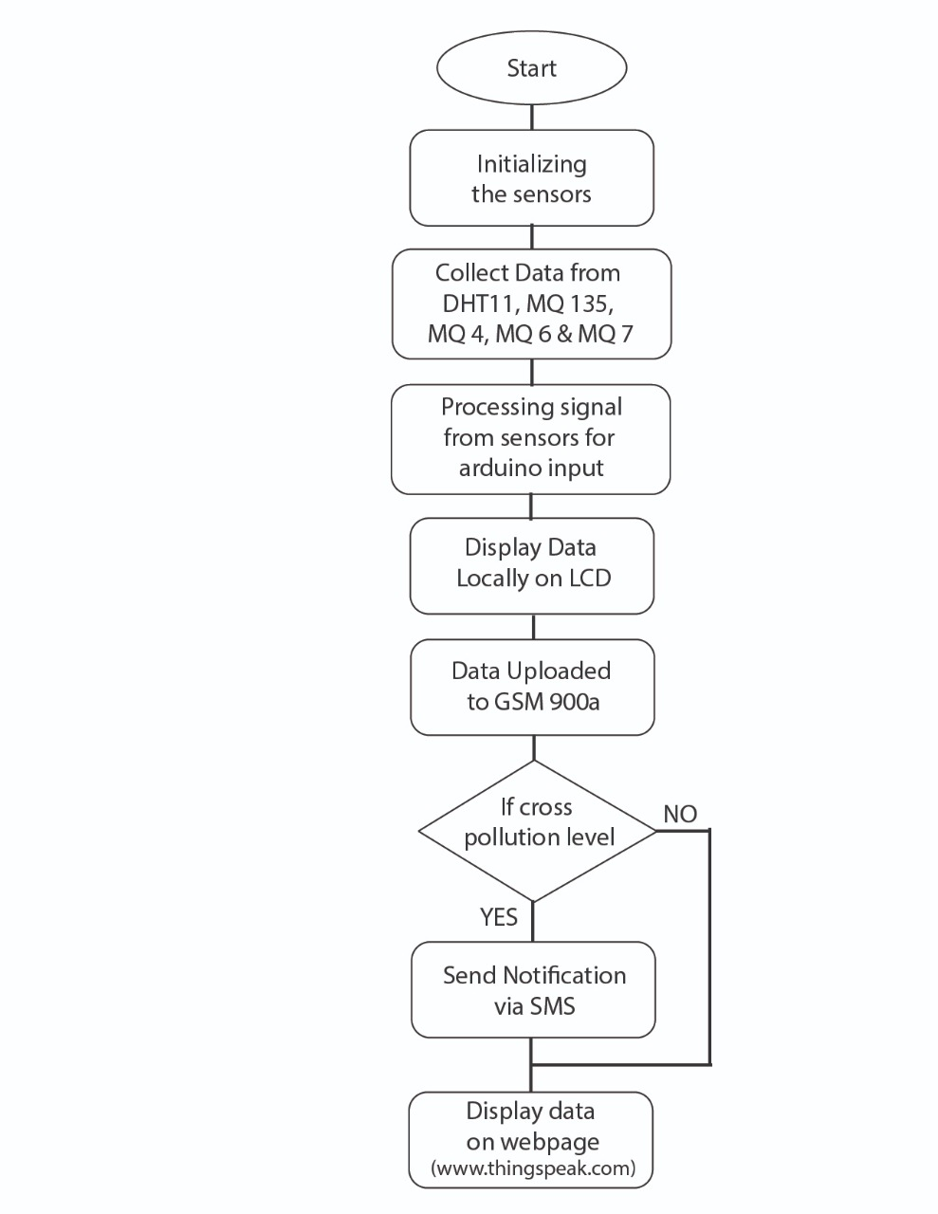
Flow chart

Slide 16
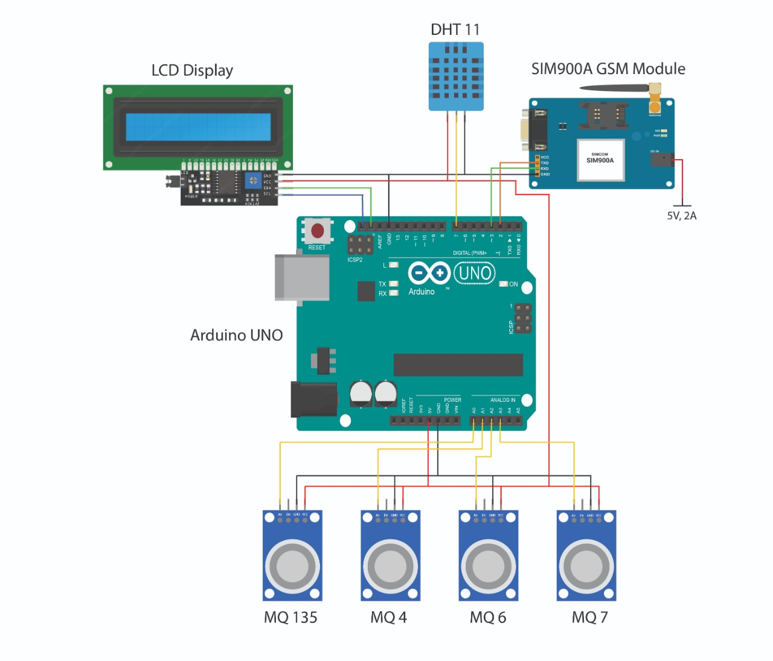
Circuit Diagram

Slide 17
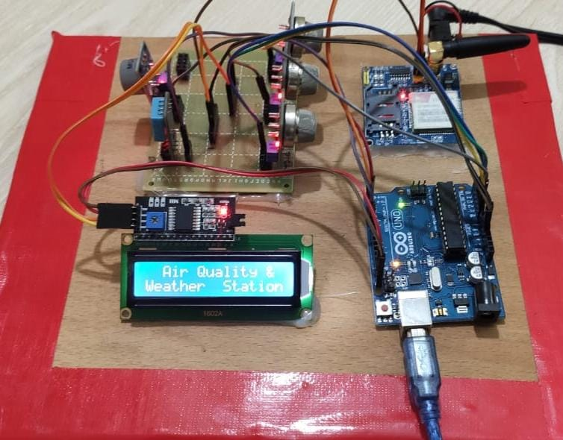
Full setup Circuit

Slide 18
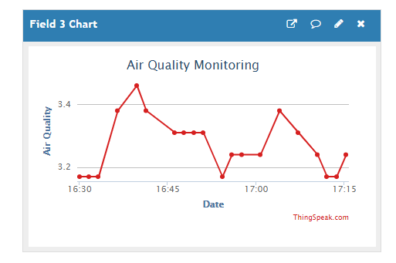
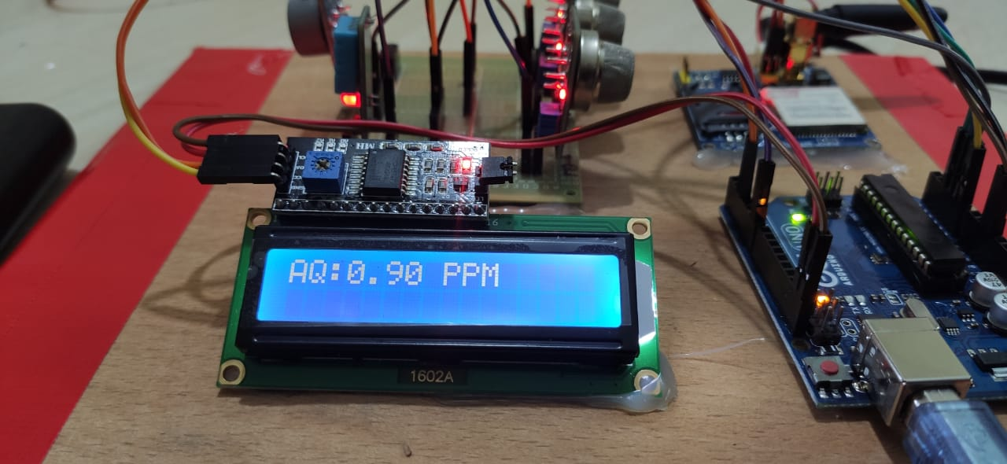
Result
Fig: LCD display view (AQ)
Fig: Cloud platform view (AQ)

Slide 19
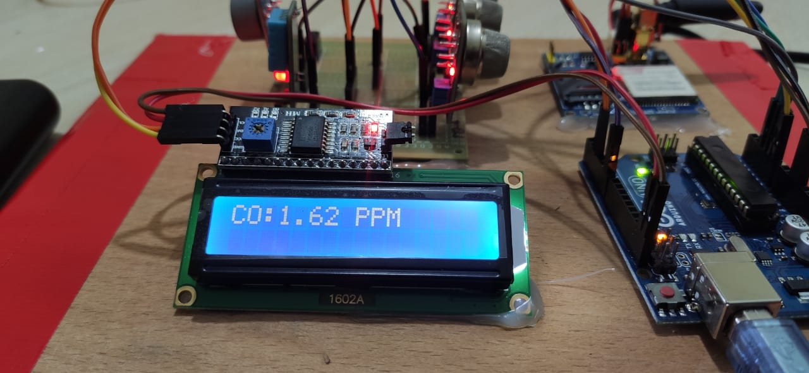
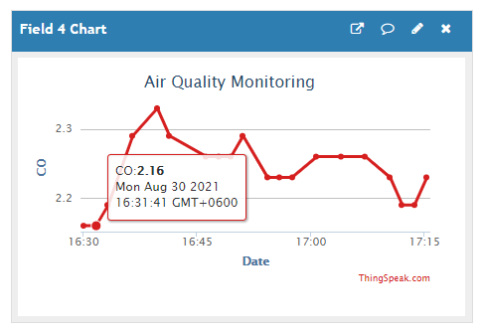
Fig: LCD display view (CO)
Fig: Cloud platform view (AQ)

Slide 20
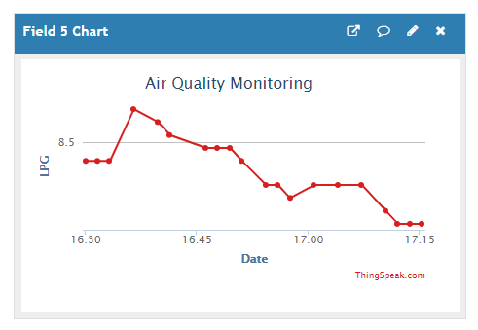
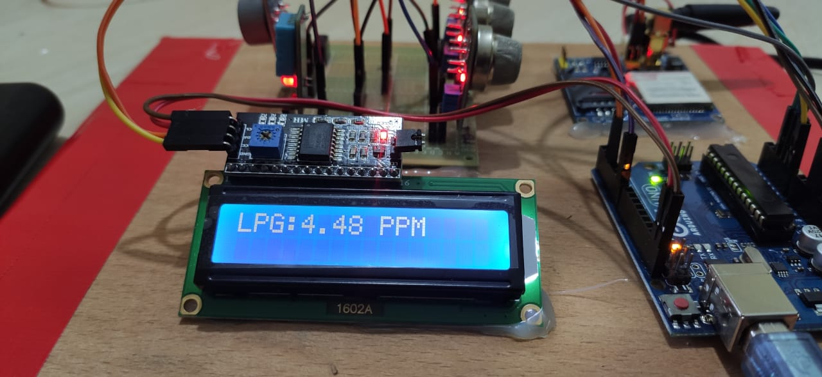
Fig: LCD display view (LPG)
Fig: Cloud platform view (LPG)

Slide 21
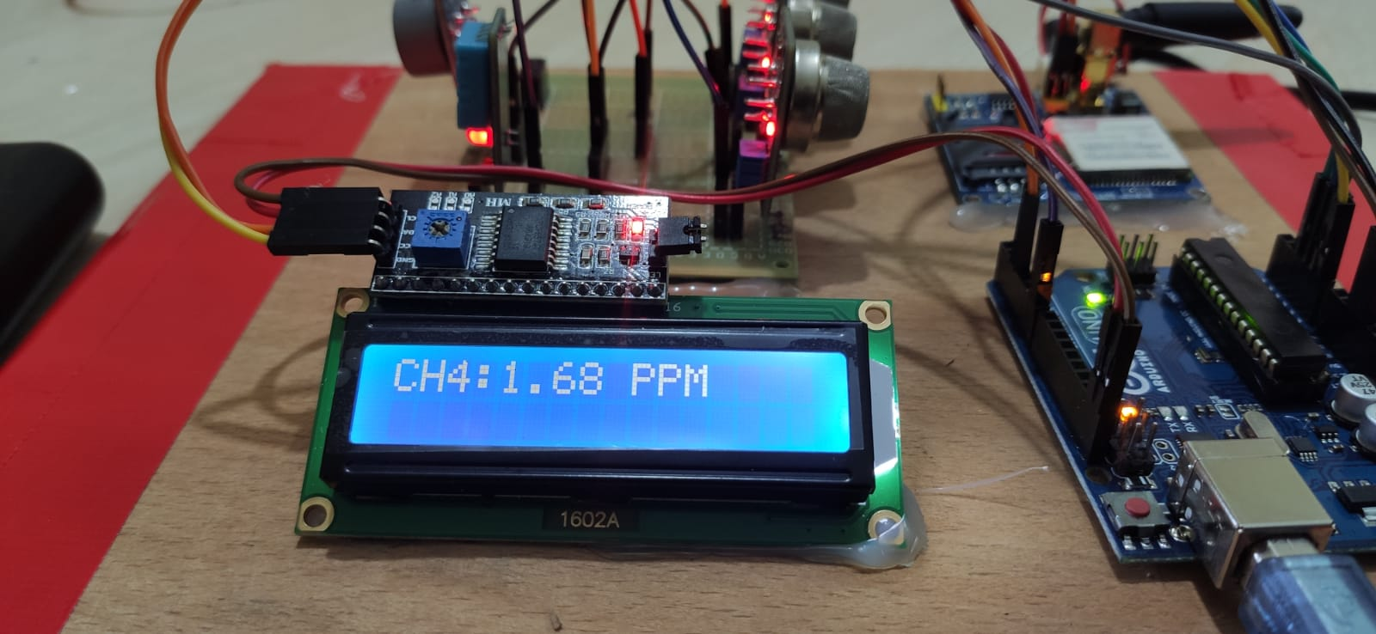
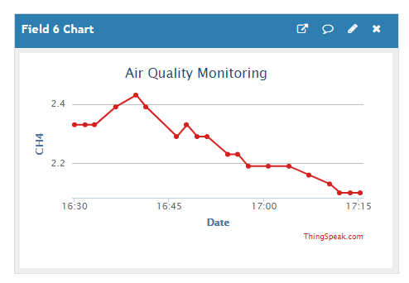
Fig: LCD display view (CH4)
Fig: Cloud platform view (CH4)

Slide 22
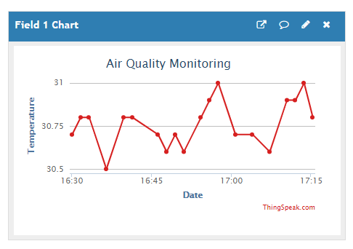

Fig: LCD display view Temperature & Humidity
Fig: Cloud platform view Temperature

Slide 23
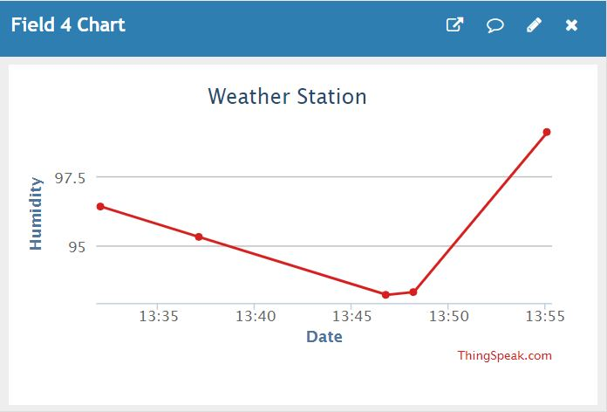
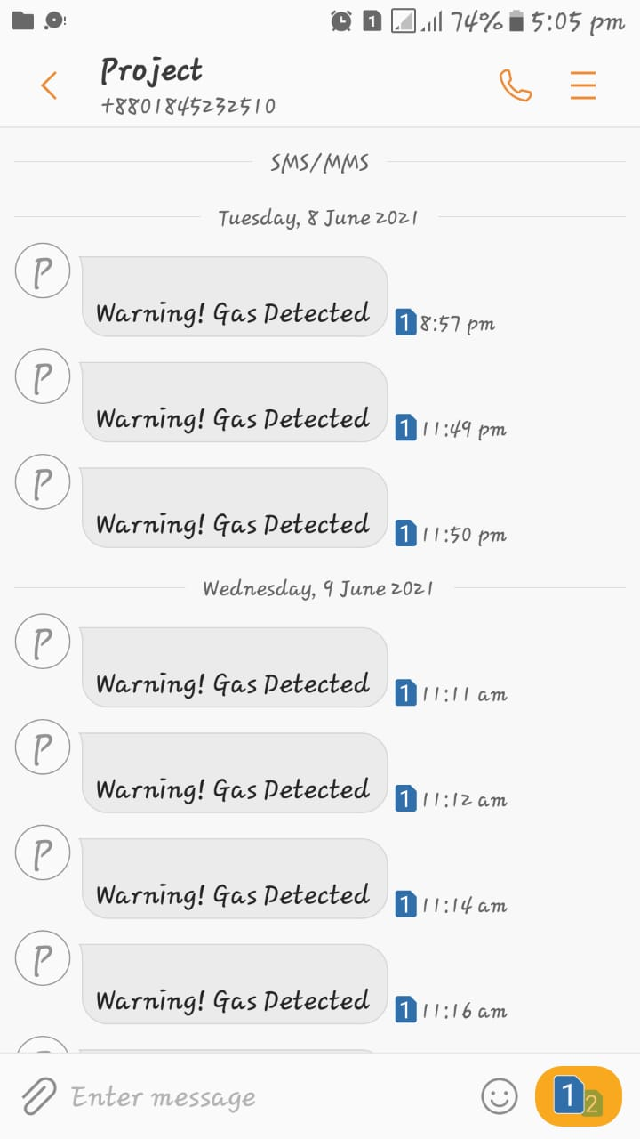
Fig: Cloud platform view Humidity
Fig: Over Gas Detection Warning Via SMS

Slide 24
Future Work
In this project model, we didn’t use any dust sensors and alarming devices to alert in danger. We will do that in future. In our model, we didn’t make this for bigger houses like offices, schools. In that case we had to use wireless sensor network. But we had a lack of budget to build such devices. In future we will work along with radiation detection and machine learning algorithms for better future air quality detection.

Slide 25
Gantt Chart
Process | 1-2-3W | 4w | 5w | 6w | 7 W | 7-8-9w | 10w | 10-11w | 12-13w | 14w | 15-16-17w | 18w | Status
Literature review |  |  |  |  |  |  |  |  |  |  |  |  | Complete
Project Title |  |  |  |  |  |  |  |  |  |  |  |  | Complete
Proposal Writing |  |  |  |  |  |  |  |  |  |  |  |  | Complete
Collection of component |  |  |  |  |  |  |  |  |  |  |  |  | Complete
Creating Working Method |  |  |  |  |  |  |  |  |  |  |  |  | Complete
Learning Necessary Programmig Language |  |  |  |  |  |  |  |  |  |  |  |  | Complete
Design Circuit Diagram |  |  |  |  |  |  |  |  |  |  |  |  | Complete
Analyze the results |  |  |  |  |  |  |  |  |  |  |  |  | Complete
Creating Database of found result |  |  |  |  |  |  |  |  |  |  |  |  | Complete
Finalize our design |  |  |  |  |  |  |  |  |  |  |  |  | Complete
Report writing |  |  |  |  |  |  |  |  |  |  |  |  | Complete
Project Review |  |  |  |  |  |  |  |  |  |  |  |  | Complete
Final report submission

Slide 26
Conclusion
An air pollution monitoring system was designed, implemented and tested. The proposed system shows better reliability because it is based on GPRS system. GPRS network is easily available and consume less bandwidth as compare to other networks. In this proposed system use Sim900A model that is contain low cost as compare to other 3G and 4G hardware. The proposed system provides high accuracy as compare to other previous method due to its low bit error rate.

Slide 27
References
[1] | Shaheduzzaman Chowdhury, MD. Shahedul Islam, Md. Kaiser Raihan and Mohammed Shahriar Aretin,“Design & Implementation of an IoT based air pollution detection & monitoring system,” 5th International Conference on Advances in Electrical Engineering (ICAEE), 26-28 September 2019, Bangladesh, pp. 296-300.
[2] | Nael Abd Alfatah Husein, Abdul Hadi Abd Rahman, Dahlila Putri Dahnil, “Evaluation of LoRa Based air pollution monitoring system,” (IJACSA) International Journal of Advanced Computer Science and Applications Vol. 10,No. 7, 2019, pp. 391-396.
[3] | Ravi Kishore Kodali' and Sasweth C. Rajanarayanan, “IoT based Indoor Air Quality Monitoring System,” IEEE Conference 2019, pp. 261-265.
[4] | Yamunathangam, K. Pritheka, P. Varuna, “IOT Enabled Air Pollution Monitoring and Awareness Creation System,” International Journal of Recent Technology and Engineering (IJRTE) ISSN: 2277-3878, Volume-7 Issue-45, November 2018, pp. 398-400.
[5] | Devahema'. P.V. Sai Surya Vamsi, Archit Garg', Abhinav Anand, Desu Rajasekhar Gupta, “IOT based Air Pollution Monitoring System,” Journal of Network Communications and Emerging Technologies (JNCET) Volume 8, Issue 4, April (2018), pp.100-103.

Slide 28
[6] | S.Muthukumar, W.Sherine Mary, Jayanthi.S, Kiruthiga.R, “IoT based air pollution monitoring and control system,” Proceedings of the International Conference on Inventive Research in Computing Applications (ICIRCA 2018) IEEE Xplore Compliant Part Number CFPISN67-ART ISBN 978-1-5386-2456-2, pp. 1286-1288.
[7] | G Spandana, Mr Shanmughasundram R, “Design and Development of Air Pollution Monitoring System for Smart Cities,” Proceedings of the Second International Conference on Intelligent Computing and Control Systems (CICCS 2018) IEEE Xplore Compliant Part Number CFP18K74-ART, ISBN 978-1-5386-2842-3, pp. 1640-1643.
[8] | Harsh N. Shah, Zishan Khan, Abbas Ali Merchant, Moin Mughal, Aamir Shaikh, Priti Rane, “IOT Based Air Pollution Monitoring System,” International Journal of Scientific & Engineering Research Volume 9, Issue 2, February-2018, ISSN 2229-5518, pp. 62-65.
[9] | Md. Mohiuddin Ahmed, Suraiya Banu, Bijan Paul, “Real-time Air Quality Monitoring System for Bangladesh's perspective based on Internet of things,” 2017 3rd International Conference on Electrical Information and Communication Technology (EICT), 7-9 December 2017. Khulna, Bangladesh.
[10] | Sagar M. Godase, Rahul C. Padalkar and M. K. Bhanarkar, “Implementation of IoT based Indoor Air Quality Monitoring System,” CURRENT GLOBAL REVIEWER: Special UGC APPROVED Sr.No-64310 SEN 2319-8648),(ICSA-2017).

